Slide 1

Digital Learning Platform
Team Members:-
Kolli Meghana Garikapati Kausthub Rao

Slide 2
PROBLEM STATEMENT
The shift toward digital learning has opened up new opportunities for students but has also introduced significant challenges. Many students struggle with staying organized, motivated, and engaged in their studies when they lack the structure of a traditional classroom environment. Managing multiple assignments, keeping track of deadlines, and finding reliable study resources can be overwhelming, particularly for students who are not accustomed to self-directed learning. While learning management systems (LMS) provide a basic framework for digital education, they often lack the personalization and support needed to address these individual challenges

Slide 3

INTRODUCTION
In the past few years , one of the most significant shift has taken place. The shift towards the digitalization. Many people are seeing new heights while many saw a hit due to this. One such field which got digitized was learning industry. Earlier , the method of educating was offline , by meeting at one fixed place , having only few resources , but now due to the shift, traditional learning is slowly been replaced with digital learning.
Traditional learning is effective at few places but most of the time it is proven and criticized as the ineffective way of learning and teaching. Even though digital learning is effective at most places it has some problems which needs a great attention. That is , making the student shift from traditional to digital.

Slide 4
OBJECTIVES
So our project, digital learning platform has the following objectives:
Provide Study Resources
Personal Doubts solver
Ensure Usability
Build a Reliable Platform
Promote Engagement

Slide 5
FUNCTIONAL REQUIREMENTS
Assignment Management: Upload and set deadlines for assignments.
Resource Support: Provide students with study materials uploaded by professors and also provides a way to search for the resources to prepare a topic in depth for professors
AI Doubt solver: AI-powered tool to answer student queries and provide clarity on topics, this solves the problem of shyness or fear to ask doubts in personal.
News Section: The best source for motivation is around you, based on this fact we are keeping a news section which provides the technology news so that students can maintain the fire of developing or contributing towards the development of a technology.

Slide 6
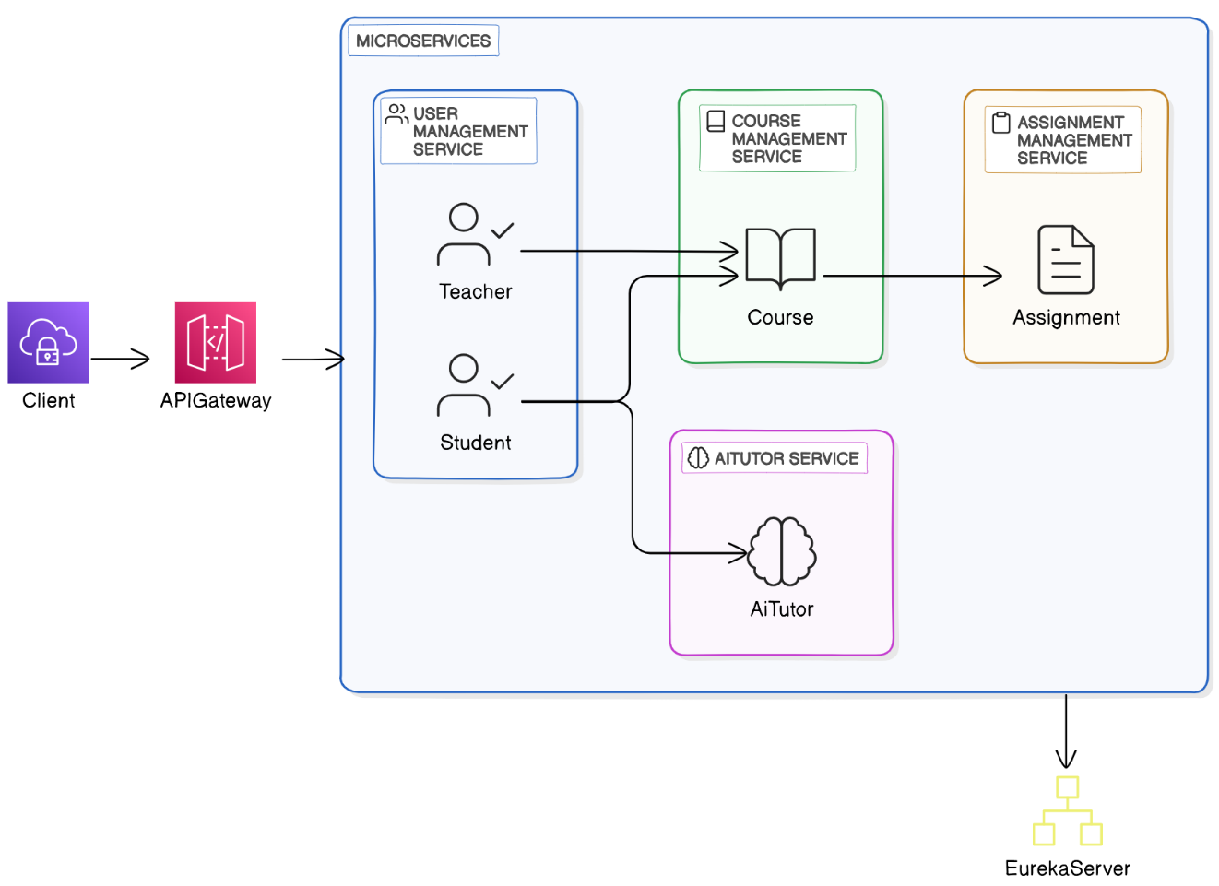
ARCHITECTURE

Slide 7
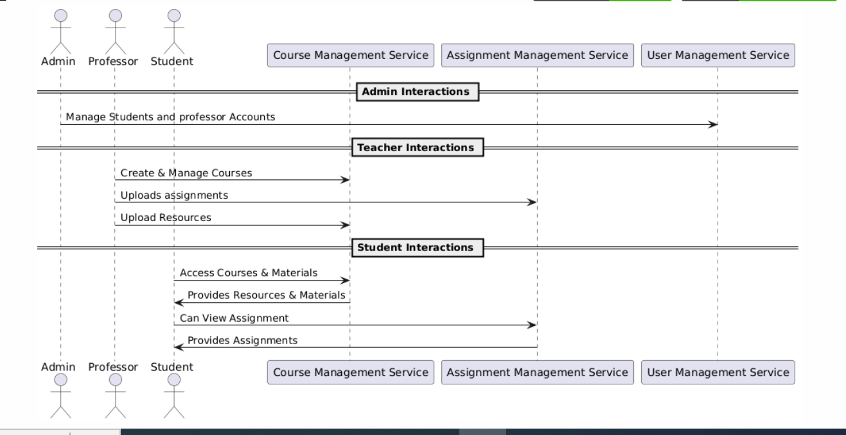
PROJECT FLOW

Slide 8
TECH STACK
FRONTEND | HTML, CSS, JavaScript, TypeScript, Angular
BACKEND | Java, Spring Boot
DATABASE | MySQL

Slide 9
CONCLUSION
This is our approach in reducing the struggles of students to migrate from the traditional classroom atmosphere to the digital learning atmosphere.
The project aims to enhance the digital learning experience by addressing the challenges students face in self-directed learning.
It provides a comprehensive platform that ensures organization, access to resources, personalized learning.
The focus on usability, performance, and reliability ensures a smooth and efficient experience for both students and teachers.

Slide 10


